Slide 1
Wildfire Analysis in the United States from 1992-2015
Mike, Ali, Victor, Shannon

Slide 3
Inspiration: Wildfires are a hot button topic in the news. We will look at data from 1992 to 2015 to answer the following questions:
Where do wildfires occur?
Are wildfires getting larger? Does temperature affect the total number?
Has there been a significant increase in wildfires?
Source - Kaggle: 1.88 million geo-referenced wildfire records, representing a total of 140 million acres burned during the 24-year period.

Slide 4

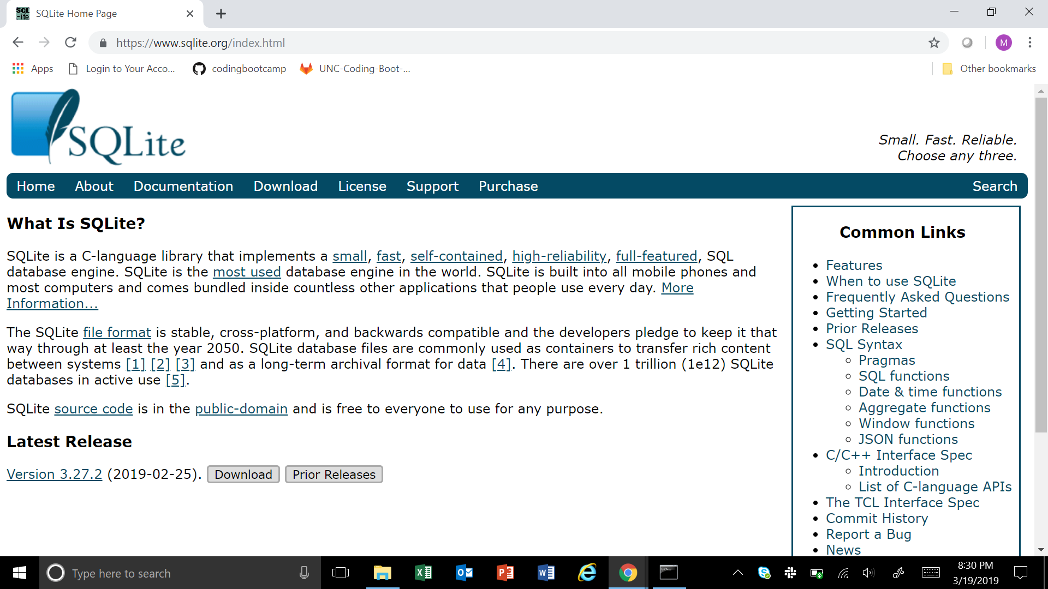
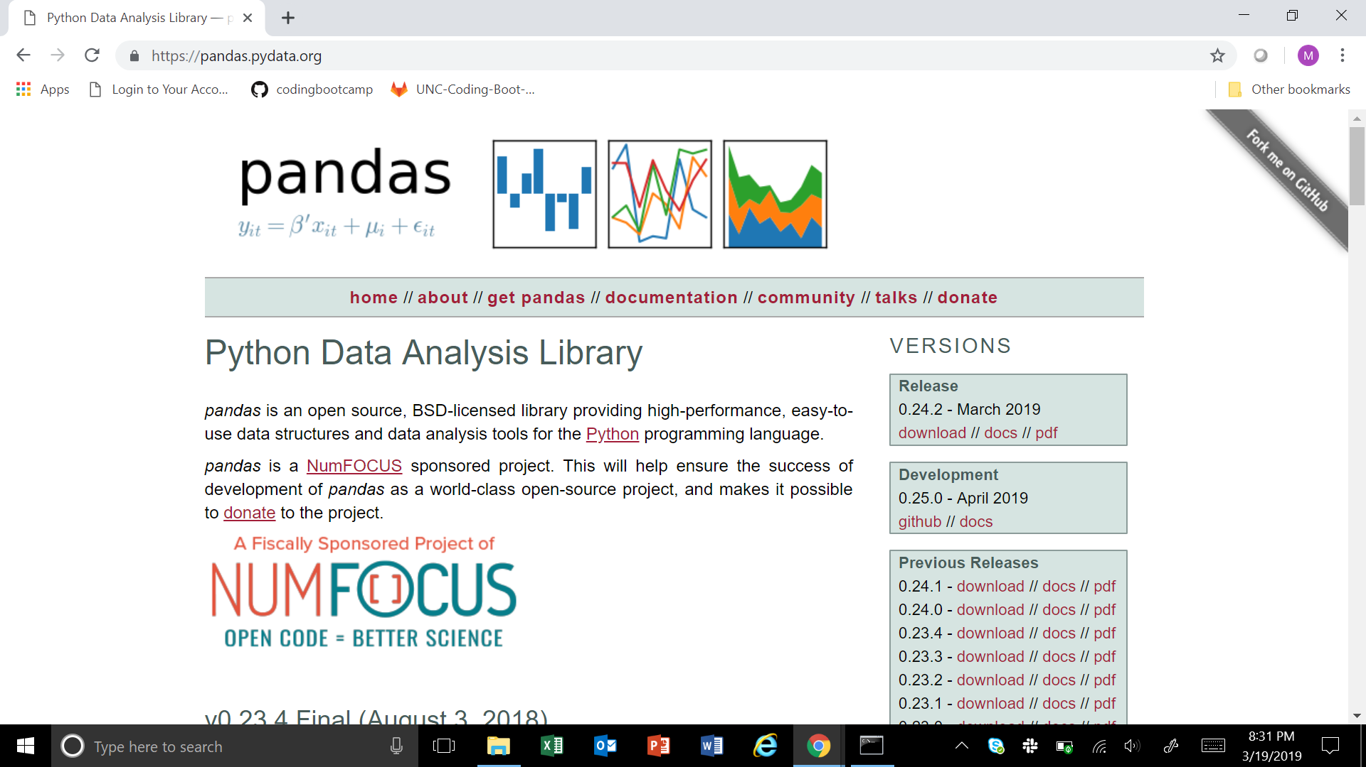
Workflow
~1Gig
~600Mb
70Mb
Remove Unnecessary Tables
Remove Unnecessary Columns
Label Columns According to Documentation
Remove Fires Under 1 Acre

Slide 5
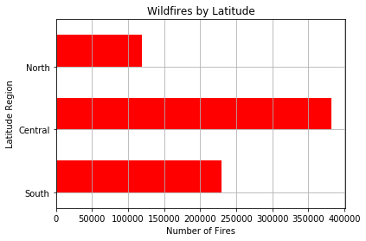
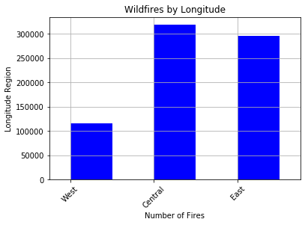
Wildfires by Latitude and Longitude

Slide 6
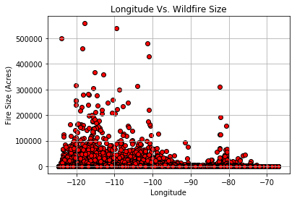

Slide 7
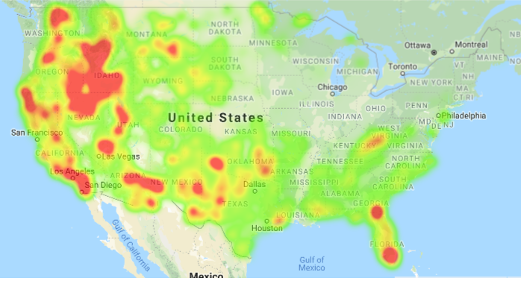
Wildfire Heat Map

Slide 8
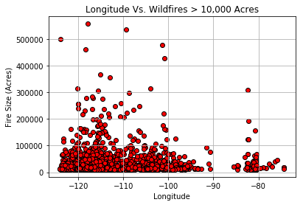
Wildfire Size (Over 10,000) Acres by Longitude

Slide 9
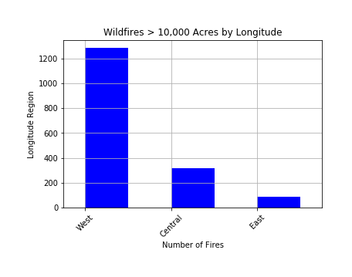
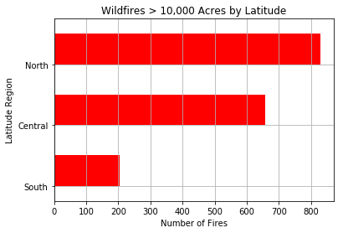
Wildfire Size (Over 10,000) Acres by Latitude and Longitude

Slide 10
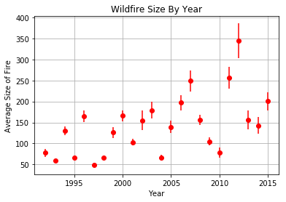
Average Wildfire Size 1992-2015

Slide 11
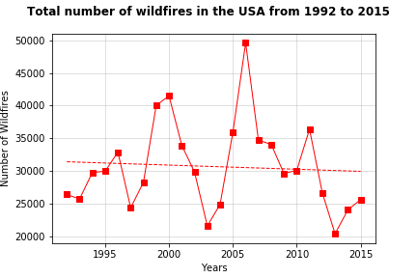

Slide 12
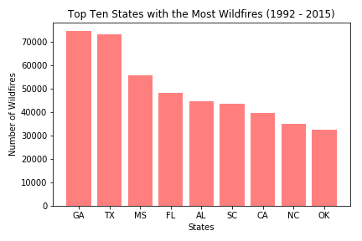
🔥 Georgia and Texas had the most number of wildfires, NC is 9th for this time

Slide 13
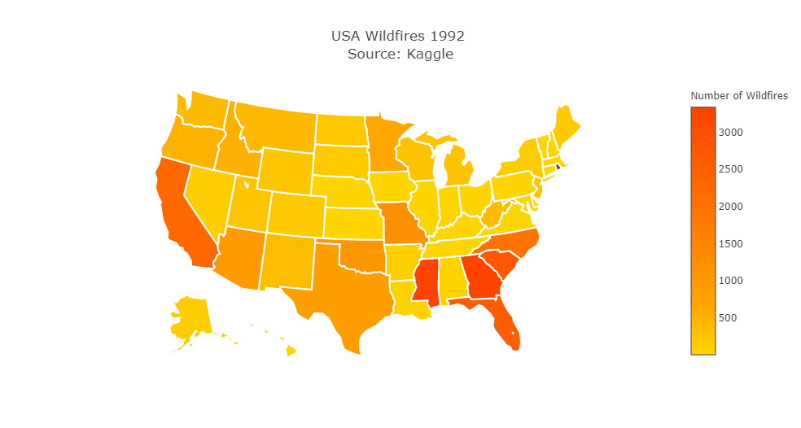
Made with plotly library and ezgif.com
Made with plotly library and ezgif.com
States in black had no wildfires that year

Slide 14
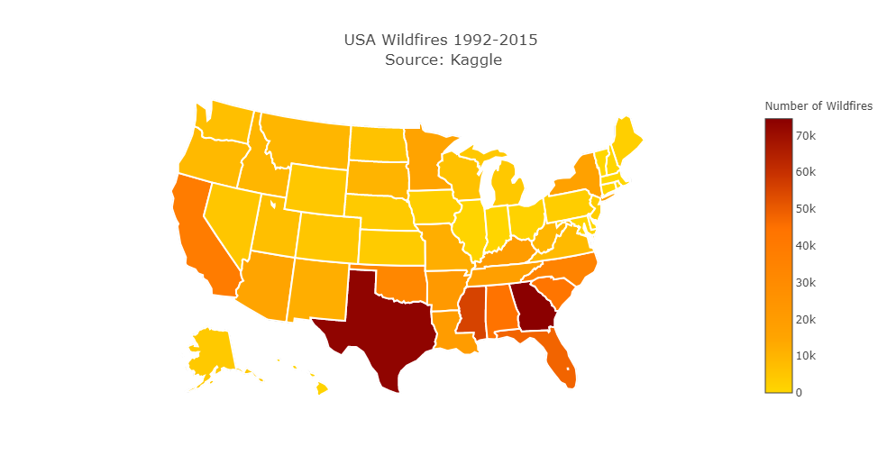

Slide 15
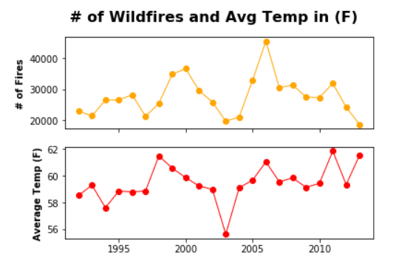
Is there a relationship between # of wildfires and average temperatures?

Slide 16
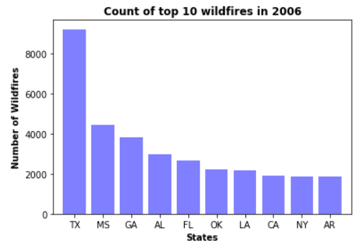
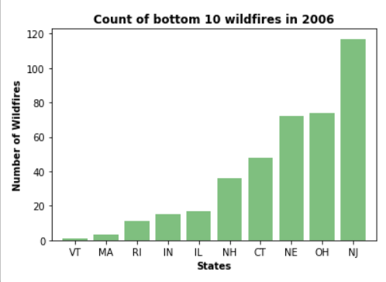
Highest and lowest # of wildfires in 2006 by states?

Slide 17
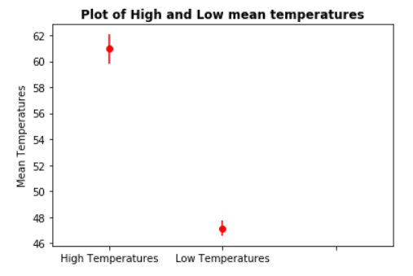
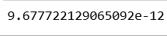
T test on the 20 highest and lowest temperatures to observe the difference in mean temperatures
P value < 0.05
The differences between the high and low temperatures are significant

Slide 18
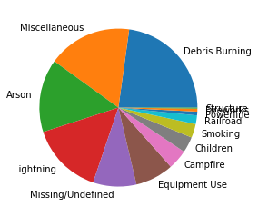
Primary Causes of Wildfires
The most prevalent causes are arson and burning debris, which make up approximately 50% of total wildfires.

Slide 19
Conclusions:
The larger fires are in the northwest.
Most wildfires are in the mid to southeast.
The average size of wildfires is growing.
There is no significant increase in the number of wildfires.
How does this affect our daily lives?

Slide 20
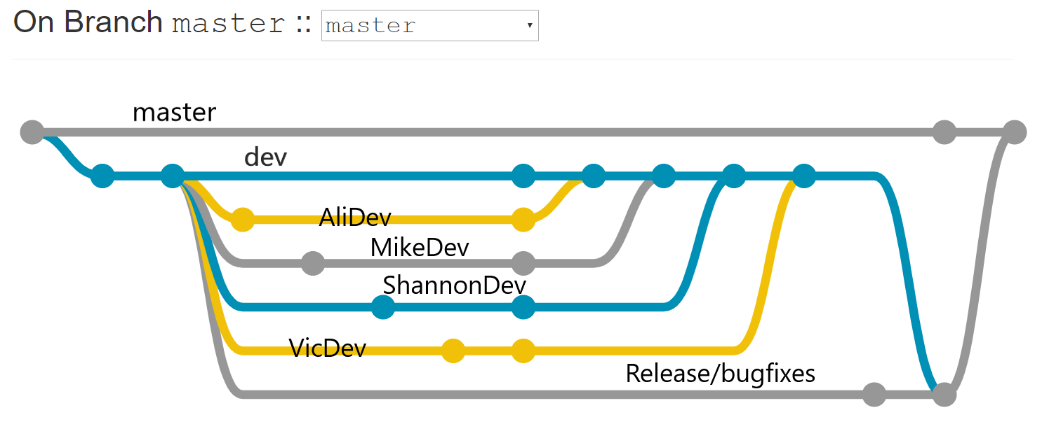
Challenges faced:
Learning Github, converting from SQL to csv, difficulty to get historical weather data (expensive), and looking into the twitter and reddit APIs
Additional questions to consider:
How soon do people post on social media about wildfires? Do people react differently in different states during the news of a wildfire?

Slide 21
Q&A with the audience
Sources:
Kaggle
National Oceanic and Atmospheric Association
Gmaps
Plotly
Tweepy (Twitter API)

